Slide 1
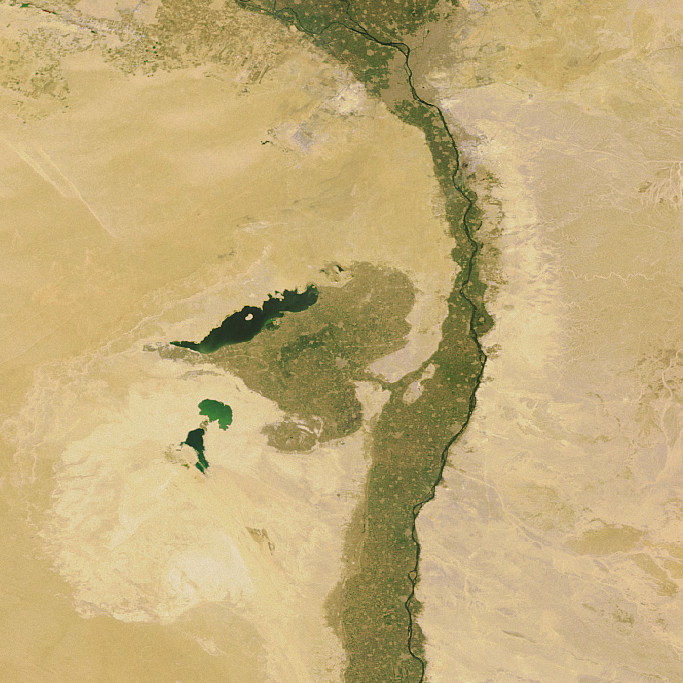
Ptolemaic Land surveys
with a focus on the Edfu land survey
Katelijn Vandorpe

Slide 2
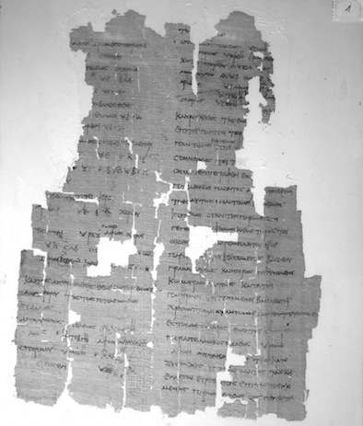
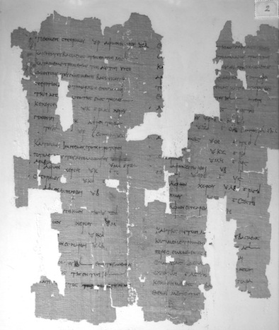
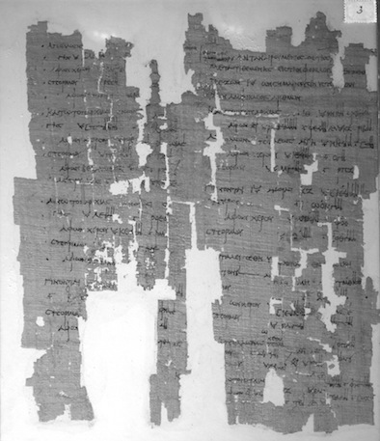
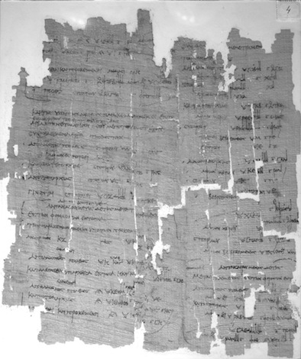
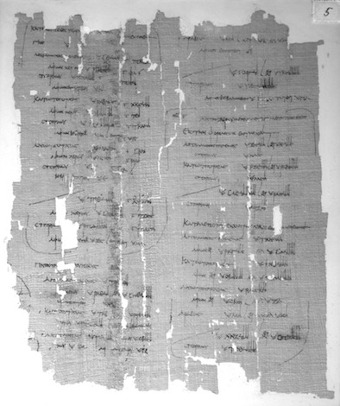
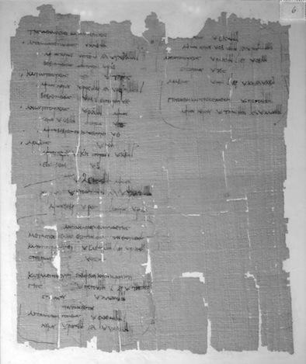
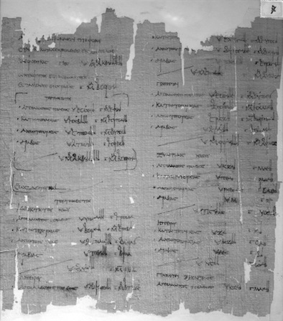
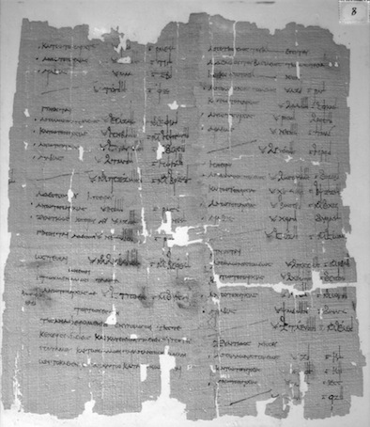
1
?
8
?
P. Haun. inv. 407, Papyrus Carlsberg Collection of the Univ. of Copenhagen
8 sheets = 16 columns: Ibscher 1912 Berlin -> Copenhagen
Rest? Only Schubart-column °2013

Slide 3
1. Main survey operations
1. a cadastral survey, drawn up after the flood (in September–October)
2. a land survey including a report of the crops or “survey of agricultural production”, drawn up in February–March after sowing and before the harvest.

Slide 4
Land survey with the crop report
at village level < komogrammateus
At toparchy-level < topogrammateus
At nome level < basilikos grammateus or royal scribe < cf. the Edfu land survey

Slide 5
Nome survey discussed in spring meeting
in the presence of the
village scribes and
probably also the topogrammateis.
Cf. Edfu land survey:
additional information, added in smaller characters often between or before the lines, by ‘the village scribes’. Lines 120–1 e.g.:
οἱ κωμογρα(μματεῖς)
τὴν ἀνταναιρ(ουμένην) οὕ(τως)
The village scribes (report on) the land subtracted as follows.
presence of topogrammateis:
cf. the numerous checking marks (small dots) that may refer to details checked by the topogrammateis and
in ll. 339–43, a correction on a total of the upper-toparchy, added in a second hand.

Slide 6
Topographical land survey with crop report (P. Tebt. 4.1119)
Topographical details
Personal details
Land type &
Crop details:
- rent/taxes
Fertile part
crops
Adjacent on the west (and the survey now proceeds from north (to south)), while the canal is in between
= the kleros-plot of the 100-aroura holder Protarchos son of Diosysios = 10 arouras, of which 5 arouras with arakos (wild chickling) and 5 arouras with phaselos (calavance/dry bean), the farmer is Cheuris.
Adjacent on the south, while the irrigation channel is in between
= Portis the elder son of Teos, Crown land, 6 arouras, of which
3 arouras rented at 3 artabas/aroura
3 arouras rented at 2 1/2 artabas/aroura,
the crops are: 3 ar. with wheat, 1 ar. with telis (fenugreek), 2 ar. with phaselos
λι(βὸς) ἐχό(μεναι) ἀρχό(μεναι) βο(ρρᾶ) \ἀν(ὰ) (μέσον) διώρυ(γος)/ κλή(ρου) (ἑκατονταρούρου) Πρώταρχος Διονυ(σίου) ι (ὧν) ἀρά(κωι) ε φασή(λωι) ε γεω(ργὸς) Χεῦρις
νό(του) ἐχό(μεναι) ἀνὰ (μέσον) ὑδρα(γωγοῦ) Πορτειοῦς μέ(γας) Τεῶτος βα(σιλικῆς) ϛ (ὧν) γ ἀν(ὰ) γ, γ ἀν(ὰ) β 𐅵 (ὧν) σπό(ρος) (πυρῶι) γ τήλει α φασή(λωι) β

Slide 7
2. The information flow
Topographical land survey with crop report
Alphabetical list by person
Alphabetical tax list by person
Village level
Village level

Slide 8
Alphabetical tax list per person
Πετεσοῦχος Πετοσίριος. θ 𐅵 δ´ (ἀρτάβαι) 4\7 𐅵̣ δ̣´/ καὶ ἀπὸ τῆς (πρότερον) Ὀρσείους β (ἀρτάβαι) ι ιβ´, (γίνονται) ια 𐅵 δ´ (ἀρτάβαι) 5\7 𐅵 γ´/ (τετρακαιεικοστῆς) 𐅵 ιβ´, θέ(ματος) 𐅵, (τρι)χ(οινίκου) α, θη(σαυροφυλακικοῦ) γ´ ιβ´, κρά(στεως) γ´ ιβ´, λοχι( ) ϛ´, γρ(αμματικοῦ) γ, (γίνονται) ϛ ιβ´, (γίνονται) 6\3 𐅵 γ´ ιβ´/. γρ(αμματικοῦ) β καὶ γεω(μετρίας) 𐅵, στεφά(νου) ε 𐅵 δ´, (γίνονται) ϛ δ´, (γίνονται) ⟦ξθ ϛ´⟧ \ο ϛ´/.
(ὧν) με(τρηθεῖσαι) Φαρμοῦ(θι) ι (πυροῦ) (ἑξα)χ(οινίκωι) λϛ γ´. \⟦Παῦνι⟧ / κθ (πυροῦ) (ἑξα)χ(οινίκωι) κα, (γίνονται) νζ γ´. λ (πυροῦ) ε 𐅵 γ´. Παῦνι ι ἀπ[ὸ] θέ(ματος) αὐ(τοῦ) (πυροῦ) α γ´. ιθ φα(κοῦ) δ, (γίνονται) εἰς (πυροῦ) ξη 𐅵. καὶ γρ(αμματικοῦ) β, (γίνονται) ο 𐅵. ⟦λο(ιπαὶ) ϛ (ὧν) (πυροῦ) β̣ φ̣α̣(κοῦ) δ̣⟧

Slide 9
2. The information flow to higher levels
Topographical land survey with crop report
Crop survey by land type
=
κατὰ φύλλον
Village level
Toparchy level
Nome level

Slide 10
Land type: Sacred land
Village level | Toparchy level | Nome level
Subcategories: land of temples of first rank, second rank, ... land of the ibiones (chapels for the sacred ibis), ... + details on farmers, surface/ crops | Subcategories: land of the great gods Stotoetis and ?Herakles … + details on farmers, surface/ crops + ? [totals] for toparchy | Subcategories: … [lost] land dedicated by Horus to minor gods land dedicated to the god Soter - details + totals of surface & crops per subcategory for toparchy and nome
Info from Fayum
Info from Herakleopolite nome
Info from Edfu nome

Slide 11
Example nome level (Edfu)
…
[(of land dedicated) - - - by Horus] of Bak(h)t(h)is to Harsemtheus-the-child
[- -] - .
[in Apollono]polis, fertile land
[at 7 (artabas)] 5 arouras, 35 (artabas) of wheat,
[of which have been so]wn 5 arouras, 35 (artabas) of wheat;
[of land dedicated to the] gods in Bakhthis
[in the upper toparchy,] fertile land at 7 (artabas), 2 arouras, 14 (artabas) of wheat,
[of which have been so]wn 2 arouras, 14 artabas;
[for the ? in Apo]llonopolis Megale
[in Arabi]a, 5 arouras, 20 (artabas) of wheat, of which
[dry land] 3 arouras, 12 artabas, fertile land 2 arouras, 8 artabas,
[uninundat]ed;
[for] the temple in Dendera
in Arabia, 5 arouras, 20 (artabas) of wheat, dry land.
Total, 127 arouras, 859 artabas, of which dry land
8 arouras, 32 artabas, fer[tile land 119 arouras], 82[7] artabas, of which have been [[inundated and also]] [sow]n 7 [arouras], 49 artabas.

Slide 12
Land type: Cleruchic land
Village level | Toparchy level | Nome level
chronological order + main subcategories: Cavalrymen Egyptian cleruchs + details on persons & plots ... | Main subcategories, no dates: Cavalrymen Egyptian cleruchs + details on persons & plots ... | chronological order + main subcategories: Cavalrymen Egyptian cleruchs - details on smaller plots + details on large plots + for smaller plots: totals of surface & crops per subcategory for toparchy and nome
Info from Fayum
Info from Herakleopolite nome
Info from Edfu nome

Slide 13
Example village level
(+ dates + names)
Example toparchy level
(+ names, no dates)
Cavalrymen
cleruchic land until year 1 of the grandfather of king... = old cavalrymen
those who became cavalrymen through Dionysios in year x
those who were promoted to the rank of cavalrymen from the rank of road inspectors in year x
those who were promoted to the rank of cavalrymen from the rank of desert guards in year
those who were promoted to the rank of cavalrymen from the rank of policemen in year x
those who became cavalrymen through Kriton in year x
those who were promoted to the rank of cavalrymen from the rank of road inspectors in year x
those who were promoted to the rank of cavalrymen from the rank of road inspectors in year x
Cavalrymen
old cavalrymen
those who became cavalrymen through Exakon
those who were promoted to the rank of cavalrymen from the rank of road inspectors
those who were promoted to the rank of cavalrymen from the rank of policemen
those who were promoted to the rank of cavalrymen from the rank of river guards
those who were promoted to the rank of cavalrymen from the rank of desert guards
those who became cavalrymen through Tothes

Slide 14
Example nome level (Edfu) + dates + names only for large plots
Cavalrymen
Land as surveyed up to year 16 (207/206 BC)
One plot of 120 ar. for a cavalryman from the polis, detailed report
Land (40 ar.) of the cavalrymen of the troop of Ptolemaios son of Apollodoros, no details for these smaller plots
Land as surveyed since year 12 (170 BC)
One plot assigned in year 15 (167/168 BC) to Pasas in city and upper toparchy; later transferred to his son Ptolemaios, 280 arouras, detailed report

Slide 15
Land type: Crown land (= Edfu: Land subject to taxes)
Village level | Toparchy level | Nome level
No subcategories in the Fayum + only the surface and crops (wheat, barley, …) are listed (no details on persons) + detailed overview of derelict land | [ - ] | Subcategories: high land island land high land and island land with brushwood no details whether wheat, barley, etc, yield reckoned in wheat (standard) + totals for toparchy & for nome in ‘columns’ + detailed overview of derelict land + dates important
Info from Fayum
Info from Herakleopolite nome
Info from Edfu nome

Slide 16
Conclusion
Subcategories !
Easy to check data
Longue durée. Key dates (BC)
Edfu land survey < 119/118 BC (Ptolemy VIII)
Key dates:
207/206 is the start of a great native revolt
180 was the first regnal year of the previous king, that is the brother of the king Ptolemy VI Philometor
170 when - in the face of the threat of a Syrian invasion under Antiochus IV - an emergency coalition was formed of the brothers Ptolemy VI and VIII together with Cleopatra II

